Slide 1
Bare International Analysis
By – Bhagyalaxmi Babu Nair

Slide 2
Evaluation of Style Advisor Performance
Comprehensive Analysis and Insights:
Evaluating the performance of a style advisor, whether human or ai-powered, involves assessing their effectiveness in providing personalized style recommendations and guidance. This can be done through various methods, including evaluating the quality and accuracy of their advice, the impact on customer satisfaction, and their ability to meet specific goals or objectives. For human advisors, performance reviews often include feedback on skills like communication, decision-making, and customer service. For ai-powered advisors, performance evaluation might focus on metrics like recommendation accuracy, user engagement, and the ability to adapt to user preferences.

Slide 3
Insights:
To effectively evaluate the performance of a style advisor, focus on assessing their expertise, communication, customer service, and impact on sales and satisfaction. Key areas to evaluate include the advisor's knowledge of current trends, their ability to understand and address client needs, their communication clarity, and their effectiveness in driving sales and positive customer experiences. Furthermore, consider gathering feedback through surveys and analyzing sales data to gain a comprehensive understanding of their performance.
Here's a more detailed breakdown of insights for evaluating a style advisor's performance:
1. Expertise and Knowledge:
Trend Analysis:
Assess the advisor's knowledge of current fashion trends and their ability to translate those trends into relevant advice for clients.
Product Knowledge:
Evaluate their understanding of the store's inventory, including fabrics, styles, and sizing, and their ability to recommend appropriate items.
Client Needs:
Gauge their ability to understand and assess clients' individual styles, preferences, and body types to provide personalized recommendations.

Slide 4
2. Communication and Customer Service:
Clarity and Effectiveness:
Evaluate how clearly and effectively the advisor communicates information about styles, trends, and product details.
Responsiveness and Timeliness:
Assess how promptly and thoroughly the advisor responds to client inquiries and addresses concerns.
Professionalism and Respect:
Evaluate the advisor's ability to interact with clients in a professional and respectful manner, creating a positive and comfortable experience.
Active Listening:
Determine if the advisor actively listens to clients' needs and preferences, demonstrating genuine interest in helping them find what they are looking for.
3. Impact on Sales and Satisfaction:
Sales Performance:
Analyze sales data to see if the advisor's recommendations lead to increased sales and conversions.
Customer Satisfaction:
Gather feedback from clients through surveys or feedback forms to gauge their satisfaction with the advisor's service and recommendations.
Repeat Business:
Track whether clients return to the advisor for future styling needs, indicating a positive experience and strong relationship.
Positive Referrals:
Determine if clients recommend the advisor to others, a strong indicator of satisfaction and trust.

Slide 5
4. Additional Factors:
Adaptability:
Assess the advisor's ability to adapt to different client personalities and preferences.
Problem-Solving:
Evaluate their ability to handle challenging situations or customer complaints effectively.
Teamwork:
Determine if the advisor collaborates effectively with other team members to create a positive shopping environment.
Continuous Improvement:
Encourage the advisor to seek feedback and identify areas for improvement in their performance.
Evaluation Methods:
Performance Reviews:
Conduct regular performance reviews, using the above criteria to assess the advisor's strengths and weaknesses.
Customer Feedback:
Collect feedback through surveys, online reviews, or in-person conversations.
Sales Data Analysis:
Track sales figures and conversion rates to measure the advisor's impact on revenue.
Mystery Shopping:
Use mystery shoppers to assess the advisor's performance in a real-world shopping scenario.
By focusing on these areas and utilizing a variety of evaluation methods, you can gain a comprehensive understanding of a style advisor's performance and identify areas for development and growth.

Slide 6
Introduction & Objectives
Introduction:
Style advisors play a crucial role in the fashion and retail industry, acting as the bridge between the customer and the product. Their ability to understand customer preferences, provide personalized recommendations, and create a positive shopping experience directly impacts sales, customer satisfaction, and brand loyalty. Therefore, a robust performance evaluation system is essential for ensuring that style advisors are effectively contributing to the business goals. This project aims to establish such a system, providing a framework for assessing their strengths, identifying areas for improvement, and ultimately, driving their professional development.
Objectives:
The project's objectives are:
Define Key Performance Indicators (KPIs)
Develop an Evaluation Framework
Implement the Evaluation System
Provide Feedback and Development
Analyze and Improv
Ensure Fairness and Transparency
Drive Business Results

Slide 7
Objectives of the analysis:
Performance Grading: Assign grades to each Style Advisor based on their Evaluation_Score.
Pivot Table Analysis: Analyze average evaluation scores by zone to understand regional performance.
High Performer Identification: Determine which region has the highest percentage of high performers.
Visualization: Create visual representations of the data to highlight key trends and insights.
Presentation Report: Summarize findings and provide recommendations for management.

Slide 8
Data Overview
Data Columns Explanation:
Evaluation_ID: Unique identifier for each evaluation record.
Evaluation_Date: Date when the evaluation was conducted.
Evaluation_Score: Score given for the evaluation.
STORE AMBIANCE, FIRST IMPRESSIONS, DISCOVERY, etc.: Various criteria used to assess the performance of Style Advisors.
Location_City, Location_State, Zone, Location_Country: Geographic details of the evaluation location.
Time of entry, Time of exit, Duration of visit (seconds): Timing details of the customer visit.
Style Advisors Present, Customers Present: Number of Style Advisors and customers present during the visit.
Age of Auditor, Gender of Auditor, Auditor Attire: Demographics and attire of the auditor conducting the evaluation.
Style Advisor Name, Style Advisor Description: Details about the Style Advisor being evaluated.
Various criteria (e.g., 1.1 - Signage Clean & Well Lit, 2.1 - First Impression): Specific aspects of the evaluation related to store ambiance, customer service, and overall experience.

Slide 9
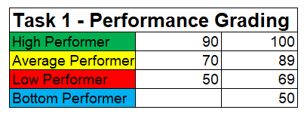
Performance Grading
Grading as per performance:
High Performer – 16%
Average Performer – 44%
Low Performer – 26%
Bottom Performer – 13%

Slide 10
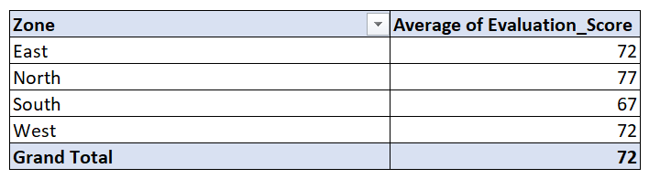
Pivot Table Analysis
Pivot table showing average Evaluation_Score by Zone:
Key observations from the pivot table:
Arranged zone wise Evaluation_score for total data set.
Through help of pivot table calculated average of Evaluation_score for all regions
Grand total average is 72.

Slide 11
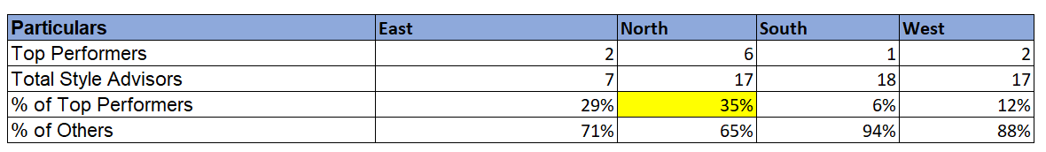
High Performer Analysis
Pivot table or chart showing percentage of High Performers by region:
Region with the highest percentage highlighted:
Region North has highest percentage of top performers i.e 35%

Slide 12
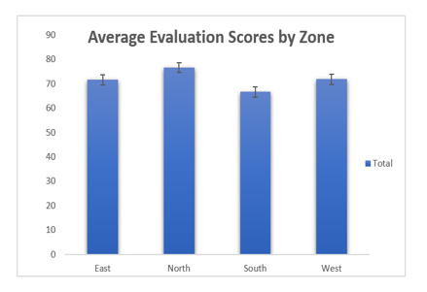
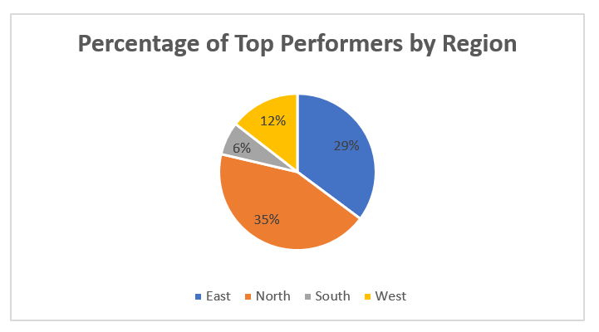
Visualizations
Average Evaluation score by zone
Percentage of High Performers by Region

Slide 13
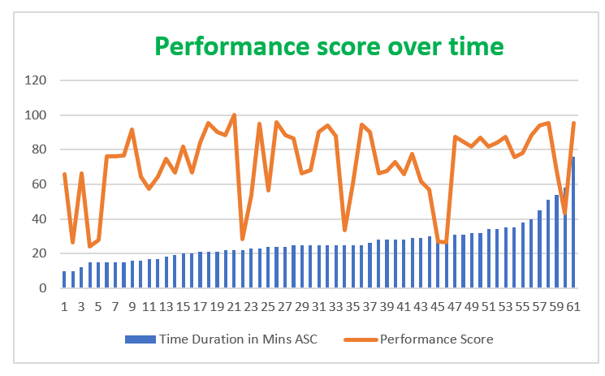
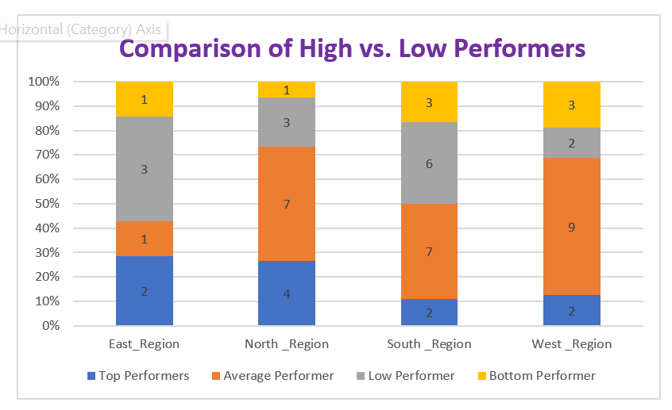
Visualizations
Performance Trends Over Time
High vs. Low Performers Comparison

Slide 14
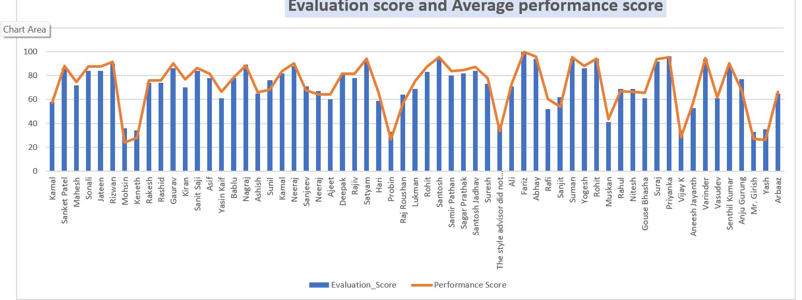
Visualizations
Breakdown by Evaluation Criteria

Slide 15
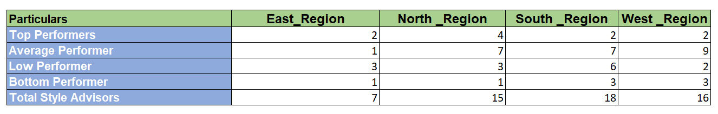
Key Insights
North region has highest score of 77.
South has lowest score of 67.
Trends observed overtime are ups and downs but later with time it was increasing.
Performance distribution analysis:

Slide 16
Recommendations
The number of Style Advisors appears to positively correlate with the performance in Trial Experience & Upsell, with a discernible increase in performance as the number of advisors increases. •
Locations with fewer Style Advisors, such as those with 1 or 2 advisors, exhibit a wider performance range from 0 to 100, suggesting variability in the quality of trial experiences and upselling efforts. •
Conversely, as the number of Style Advisors increases to 3 or 4, the performance range becomes narrower, indicating a more consistent and potentially higher-quality trial experience and upselling across these locations.
To enhance performance in Trial Experience & Upsell, consider optimizing the staffing levels of Style Advisors based on the observed correlation, ensuring adequate coverage to maintain consistent service quality and maximize upselling opportunities.
The majority of auditors are male, comprising 74% of the total, while females make up 26%.
Age-wise, the highest number(24) of auditors falls within the 27-37 age range, whereas the 57- 67(3) age group has the fewest auditors.
Interestingly, female auditors tend to provide higher evaluation scores compared to their male counterparts.

Slide 17
It's notable that auditors below the age of 40 tend to assign lower evaluation scores, suggesting potential areas for improvement in training or support.
To enhance overall performance, consider implementing targeted training programs and support systems, especially focusing on male auditors and younger team members, to boost their evaluation scores and ensure consistent quality across all demographics.
The majority of visits fall within the duration range of 500 to 2500 seconds, indicating that this is the most common timeframe for customer interactions with Style Advisors.
While there appears to be a slight positive correlation between the duration of the visit and the evaluation score, the relationship is not significant. This suggests that factors other than the length of the visit may have a greater influence on the overall evaluation score.
The number of Style Advisors appears to positively correlate with the performance in Trial Experience & Upsell, with a discernible increase in performance as the number of advisors increases.
Locations with fewer Style Advisors, such as those with 1 or 2 advisors, exhibit a wider performance range from 0 to 100, suggesting variability in the quality of trial experiences and upselling efforts.
Conversely, as the number of Style Advisors increases to 3 or 4, the performance range becomes narrower, indicating a more consistent and potentially higher-quality trial experience and upselling across these locations.

Slide 18
To enhance performance in Trial Experience & Upsell, consider optimizing the staffing levels of Style Advisors based on the observed correlation, ensuring adequate coverage to maintain consistent service quality and maximize upselling opportunities.
Among the top 10 high performers, there is a notable consistency in delivering exceptional evaluation scores, with median scores around 90 and above. This indicates a strong commitment to providing outstanding service and customer experiences.
The bottom 10 performers, however, demonstrate a considerable performance gap compared to the top performers, with median scores around 35. This suggests areas for improvement in delivering satisfactory customer interactions and experiences.
To maintain the high standards set by the top performers and bridge the performance gap among the bottom performers, targeted training and development programs should be implemented. These programs can focus on areas such as product knowledge, customer engagement, objection handling, and after-sales care to enhance overall performance.
Regular performance reviews and feedback sessions should be conducted with both top and bottom performers to recognize exemplary performance, identify areas for improvement, and provide support and resources necessary for continuous growth and development.

Slide 19
Conclusion
The project performance analysis of Style Advisors indicates a mixed bag of results, with some advisors exceeding expectations while others fall short. The key to improving performance lies in understanding the contributing factors and implementing targeted interventions. This includes assessing the current processes, leadership styles, and the use of appropriate tools and technologies, as well as focusing on individual development and team dynamics.
In conclusion, the Style Advisor Performance Evaluation project successfully assessed the effectiveness of the style advice provided. The project identified key areas of strength in the advisor's performance, such as their ability to understand client preferences and offer relevant recommendations. Areas for improvement were also highlighted, including refining the communication style and providing more tailored advice for specific situations. By analyzing both the strengths and weaknesses, the evaluation provides valuable insights for future training and development of the style advisor, ultimately leading to improved client satisfaction and business outcomes.

Slide 20
Here's a more detailed breakdown of the conclusion:
Overall Performance:
The project demonstrated that the Style Advisor is generally effective in providing style advice, with a positive impact on client satisfaction.
Strengths:
The evaluation highlighted the advisor's strengths in understanding client preferences, offering relevant recommendations, and providing a positive client experience.
Areas for Improvement:
The evaluation also identified areas where the advisor could improve, such as refining their communication style and tailoring advice more specifically to individual client needs and situations.
Future Recommendations:
The evaluation results will be used to inform future training and development initiatives for the Style Advisor, with the goal of enhancing their skills and improving the overall quality of service.
Impact:
By addressing the identified areas for improvement, the Style Advisor can further enhance their performance, leading to increased client satisfaction and positive business outcomes.

Slide 21


